Slide 1
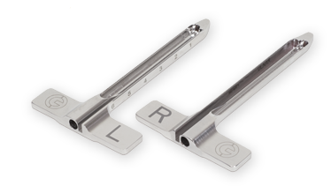
SegWAY Orthopaedics Where tradition meets technology
The Synchronized Endoscopic Guide system
Guest Speaker
Dr…………….. , MD
Facility……….

Slide 2
System Complexity
Surgeon Reluctancy.
Why have surgeons been reluctant to convert to ECTR in the past?
Nerve injury, Palmer Arch complications
Incomplete release
Time and cost.
Trust in the safety of the Endoscopic systems
How the SegWAY System overcomes these objectives
Left and Right guides functions as a retractor offering largest unobstructed field of view.
Unique ability to be able to probe and rasp under direct visualization.
The scope and the instruments work independently of each other giving a tactile feel and the option of using these instruments if needed.
The case time is comparable to an open (4 to 10min)
System utilizes a standard 4mm or 2.7mm 30° scope (Trays are provided)

Slide 3
Patient Benefit
Faster Short term recovery and return to work
Ability to do Bilateral’s as the incision is in the wrist and out of the palm.
Patent satisfaction.
How changing to Endoscopic has changed my practice.
Marketing
Reputation
Reproducibility
Patient satisfaction

Slide 4
National average CPT CODE Reimbursement – Carpal Tunnel Release
Endoscopic 29848 ASC Outpatient
Facility FEE* $1,339 $1,201
Physician FEE* $435 $529
Open 64721 ASC Outpatient
Facility FEE* $446 $692
Physician FEE* $387 $350
Reimbursement is dependent on local wage index and may vary
*This information was taken from www.FASA.org and www.CMS.org website

Slide 5
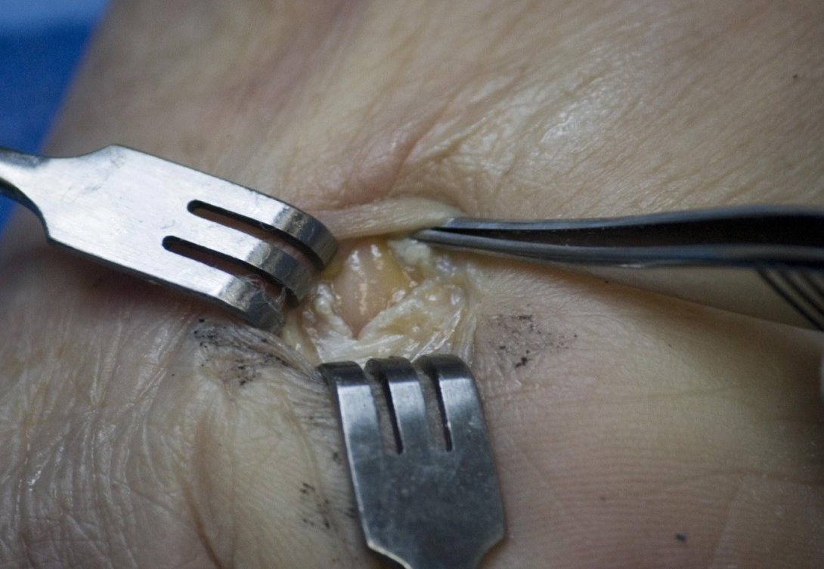
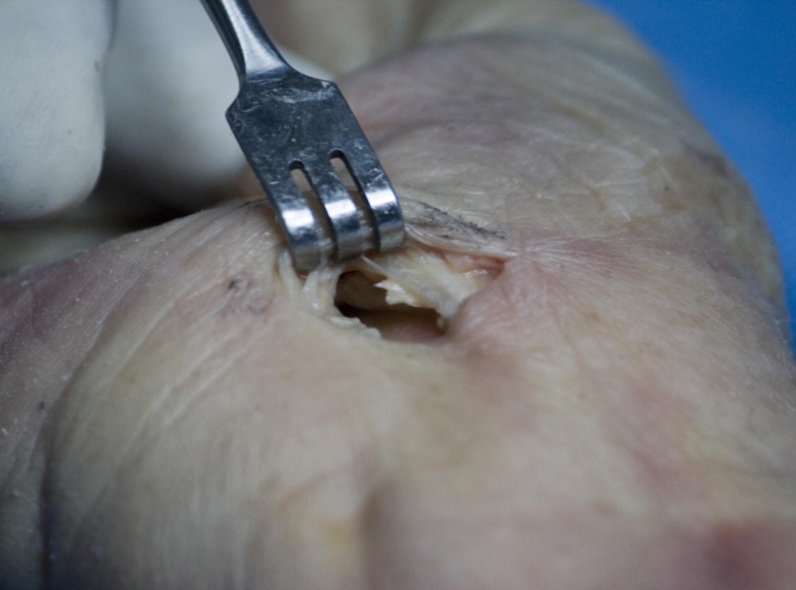
Gaining Access to the Carpal Tunnel
A 1cm incision is made between the first and second crease on top of Palmaris
Identify the following:
Median nerve
Proximal edge of ligament

Slide 6
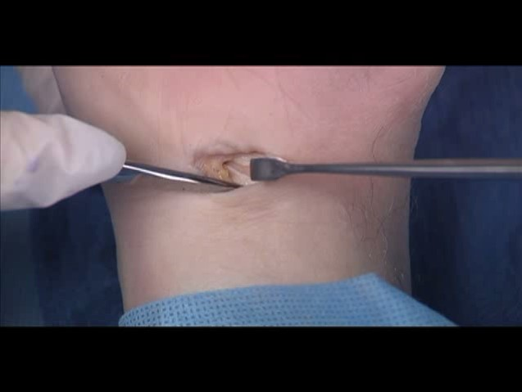
If Palmaris Longus is present retract to the medial side

Slide 7
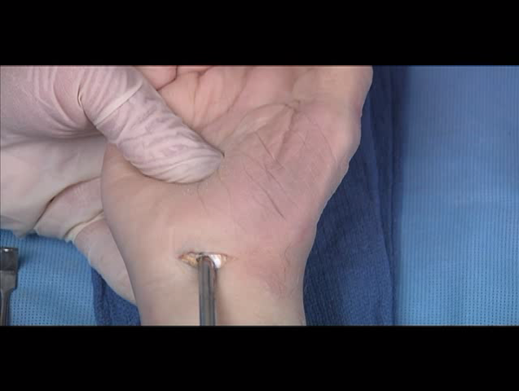
Insertion of a series of Dilatators and elevator to gain access for the guide

Slide 8
Insertion of the Guide. Left, right specific.

Slide 9
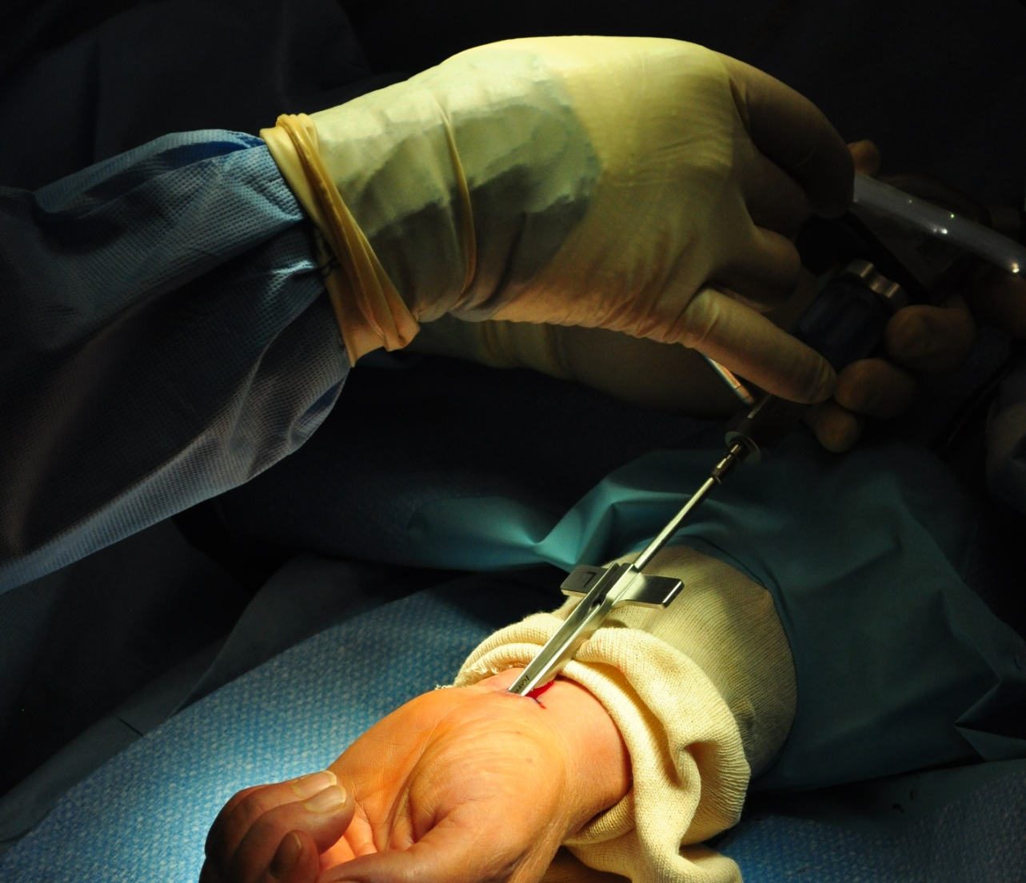
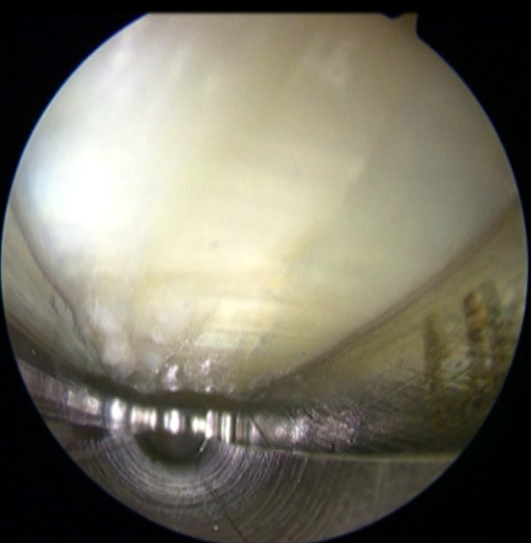
Insertion of the Scope

Slide 10
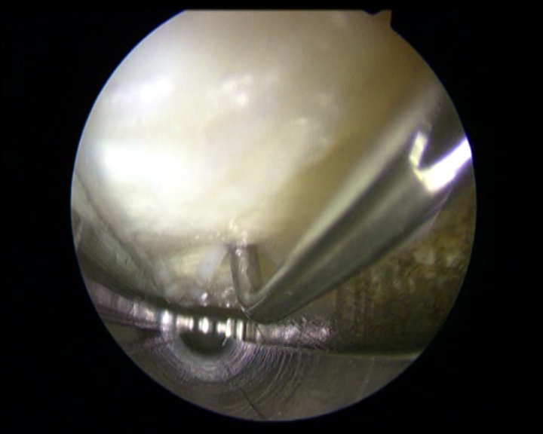
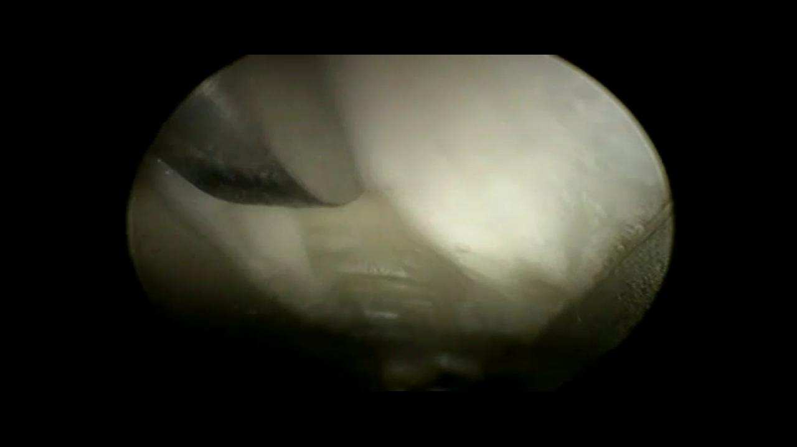
Guide with Probe Inserted
Guide with Rasp Inserted

Slide 11
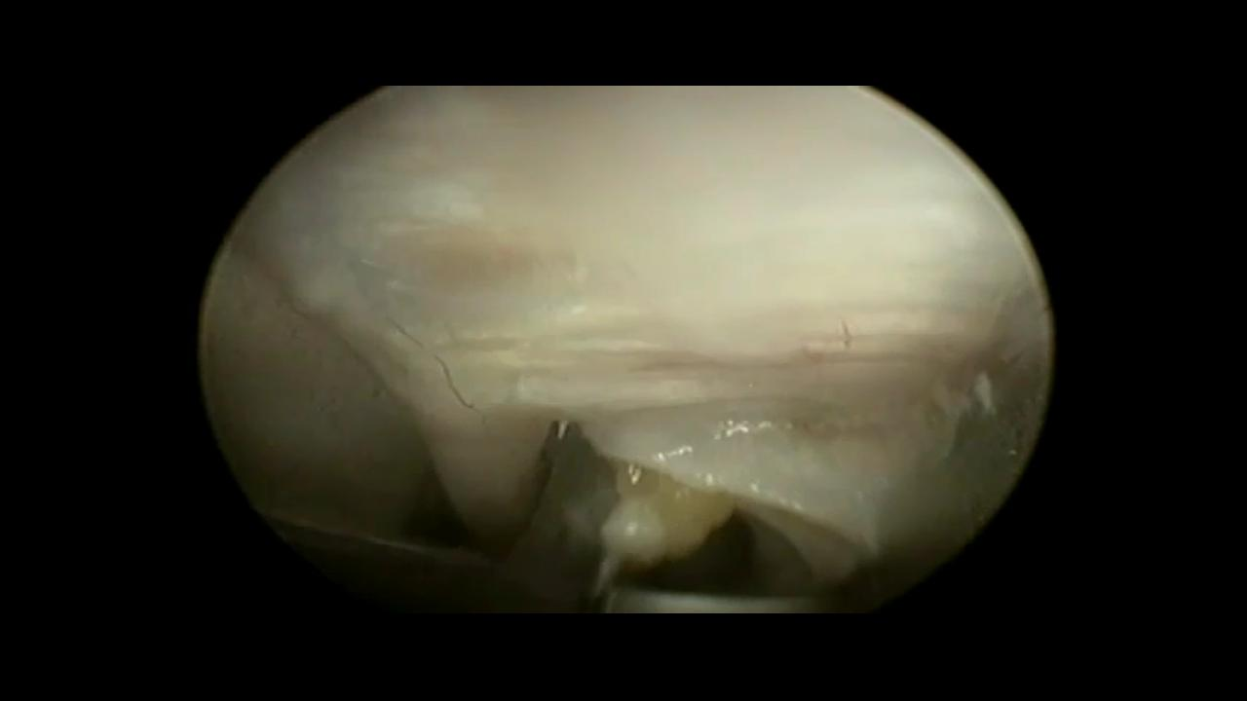
Knife hooking the distal edge of ligament

Slide 12
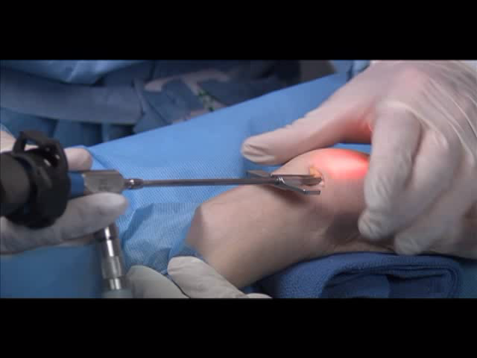
Complete Proximal and Forearm Fascia Release

Slide 13
SEG-WAY Features and benefits
SAFETY FIRST - ANATOMY SPECIFIC Left and right guides place the blade in the Ulnar Zone
- PATIENT SPECIFIC Different size guides for smaller and larger hands
- LARGER FIELD OF VIEW a wider, longer, panoramic field of view
ASSURANCE - VISUALLY RASP transverse fibers before release
VERSATILITY - VISUALLY PROBE the distal end before release
CONFIDENCE - VISUALLY PROBE uncut fibers to ensure a complete release
PATIENT - UNIPORTAL smaller incision in the wrist
SATISFACTION

